Slide 1
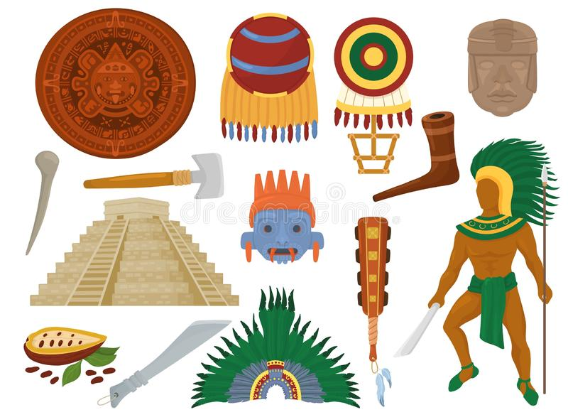
UNIT 1
The ancient Mayans
LESSON 1

Slide 2
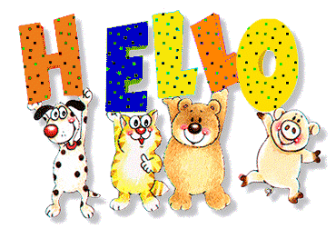

Slide 3
WATCH THE VIDEO CLIP

Slide 5
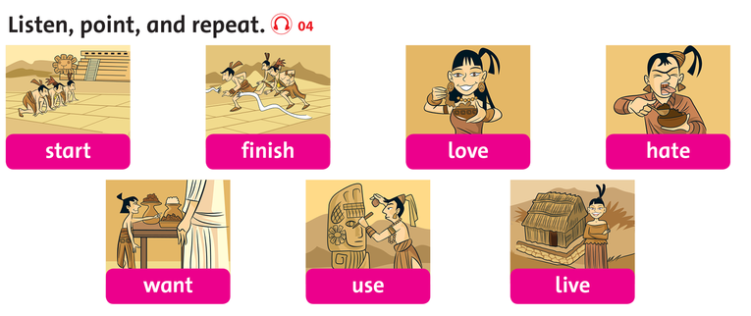

Slide 6
LISTEN AND POINT

Slide 7
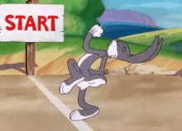
start

Slide 8
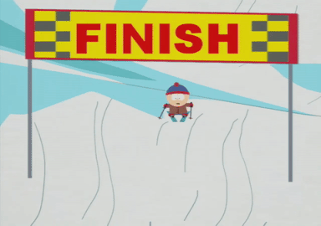
finish

Slide 9
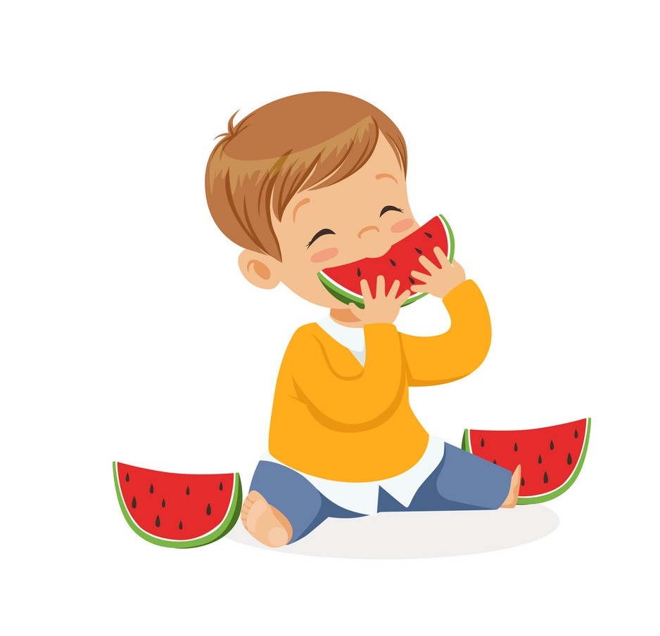
love

Slide 10
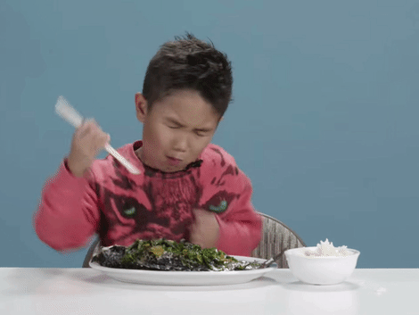
hate

Slide 11
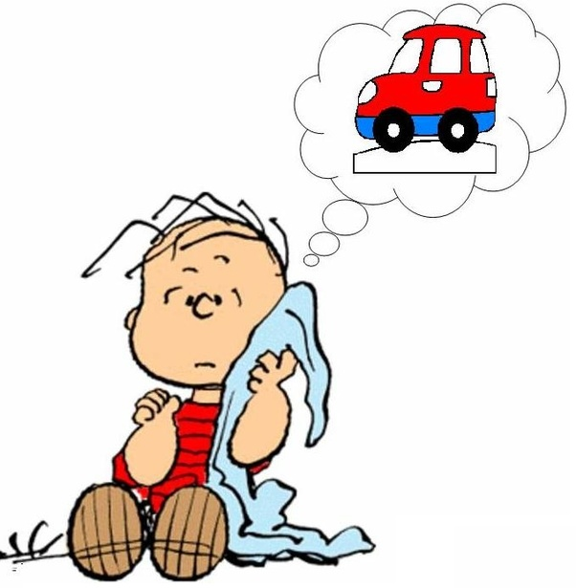
want

Slide 12
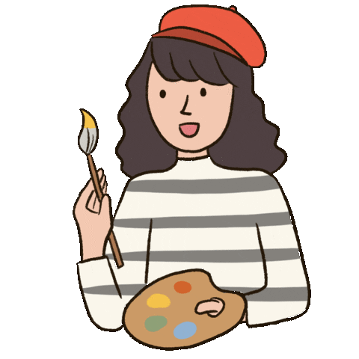
use

Slide 13
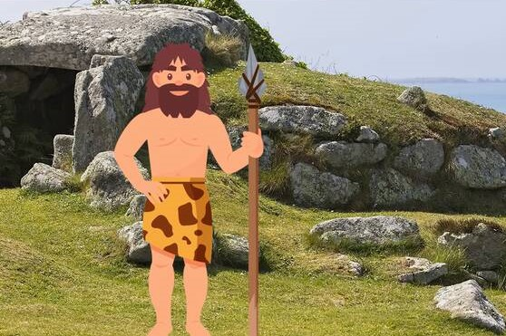
live

Slide 14
LISTEN AND REPEAT

Slide 15
start

Slide 16
finish

Slide 17
love

Slide 18
hate

Slide 19
want

Slide 20
use

Slide 21
live

Slide 22
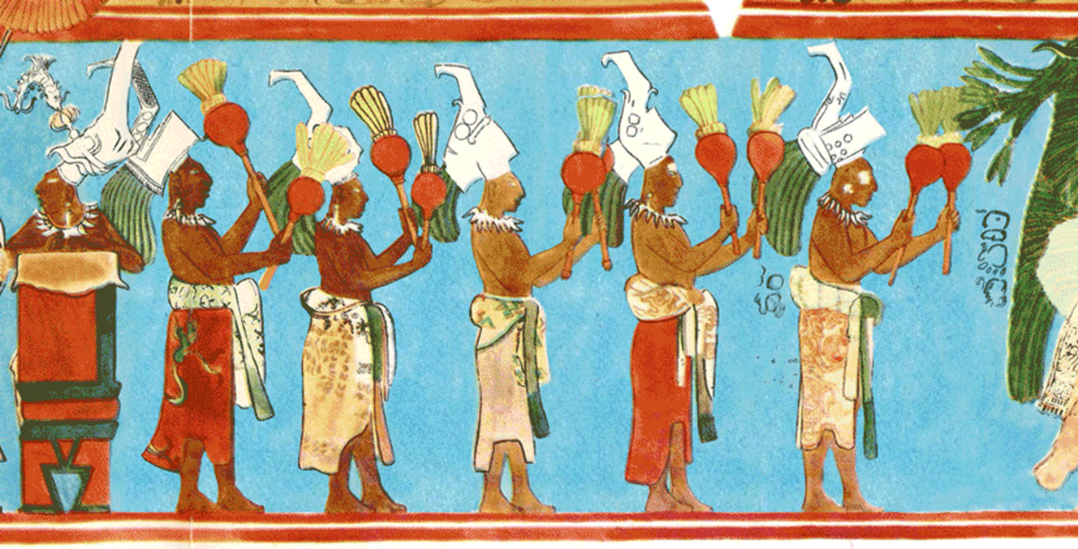
GAMETIME

Slide 23
Click on the right word
want
use
live

Slide 24
Click on the right word
use
finish
love

Slide 25
Click on the right word
hate
love
use

Slide 26
Click on the right word
hate
love
use

Slide 27
Click on the right word
hate
want
live

Slide 28
Click on the right word
live
finish
start

Slide 29
Click on the right word
start
finish
hate

Slide 30
WATCH THE VIDEO CLIP
ANSWER THESE QUESTIONS:
Where are the people?
What are they doing?
How many people are there?

Slide 32
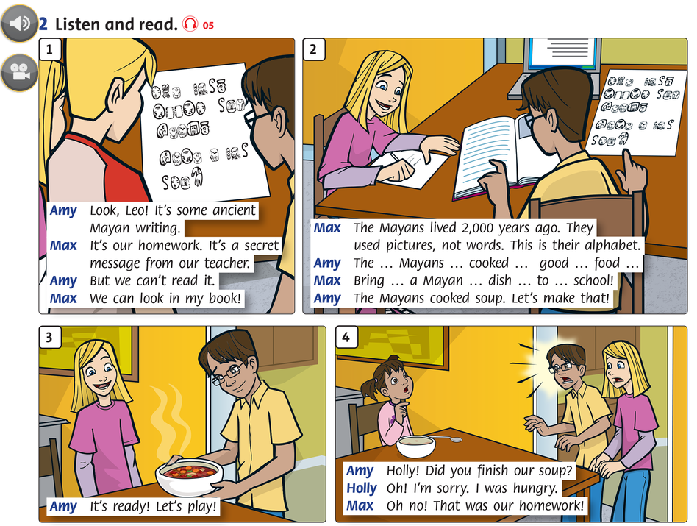

Slide 33
GROUPWORK

Slide 34
WORKBOOK TIME

Slide 35
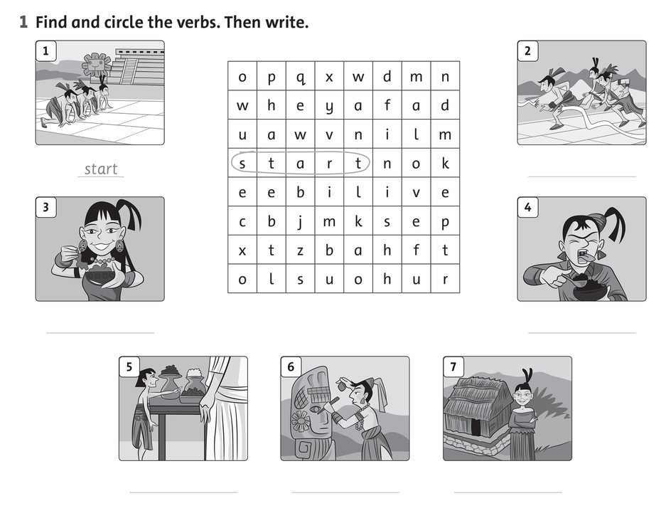

Slide 37
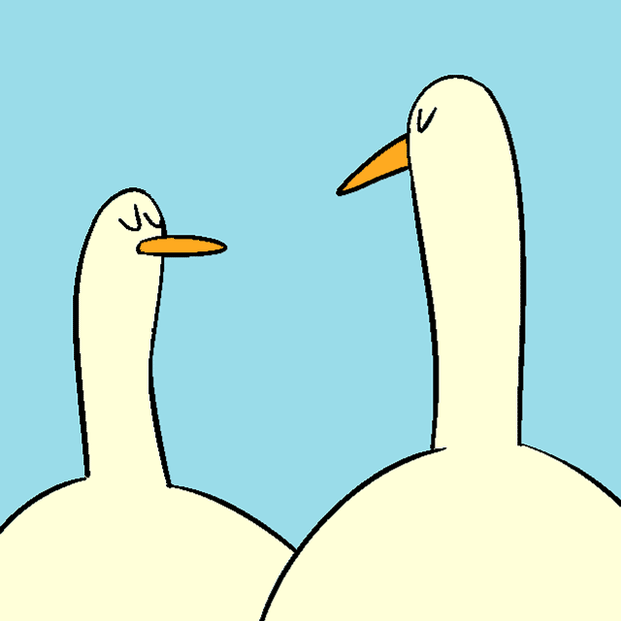
GOODBYE!!!

